Slide 1
MCH4921 Mechatronics System Design- Final Project
Group 1-6
Ahmet Burak Akyüz 1904193
Oğuzhan Berke Yeşildağ 1803798
Yarkın Seymen 1903007
Onur Karaer 1803911

Slide 2







Problem and Sub-Project Identification
Problem: Designing, modelling and simulation of a Ball-on-Plate System as reallistic as possible
Sub-Projects:
Modelling
Dynamical Modelling of the System
Newtonian, Lagranian and Hamiltonian Mechanics →
Euler-Lagrange Calculations
CAD Design according to design specifications
Fusion 360, SOLIDWORKS, CATIA → SOLIDWORKS
Verification of design via Structural testing
ANSYS Workbench, SIEMENS NX →
ANSYS Workbench
Simulation/Control
Deriving the Transfer Function and calculating PID coefficients of the system.
Applied Control Theory
Successfully implementing PIDs into the simulation environment.
CoppeliaSim, Gazebo, MATLAB/Simscape Multibody Environment → Simscape Multibody Enivronment
PID tuning according to performance tests.
Software/Simulation testing & Troubleshooting
Sensing
Deciding a sensing type that is also applicable in real life.
Visual Sensing (Camera), Touchscreen →
Touchscreen
Correctly sensing and outputting position.
Sensor Tuning and Testing.

Slide 3
Sub-Project Distribution
Ahmet Burak Akyüz 1904193 → Mechanical modelling and structural testing
Berke Yeşildağ 1803798 → Simulation implementation and performance testing.
Yarkın Seymen 1903007 → Dynamics and Control Law derivation.
Onur Karaer 1803911 → Sensing Implementation.

Slide 4
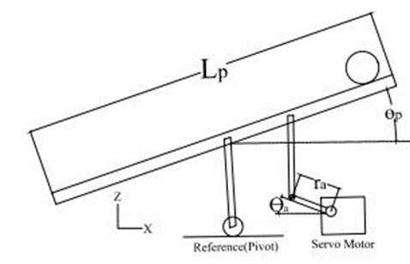
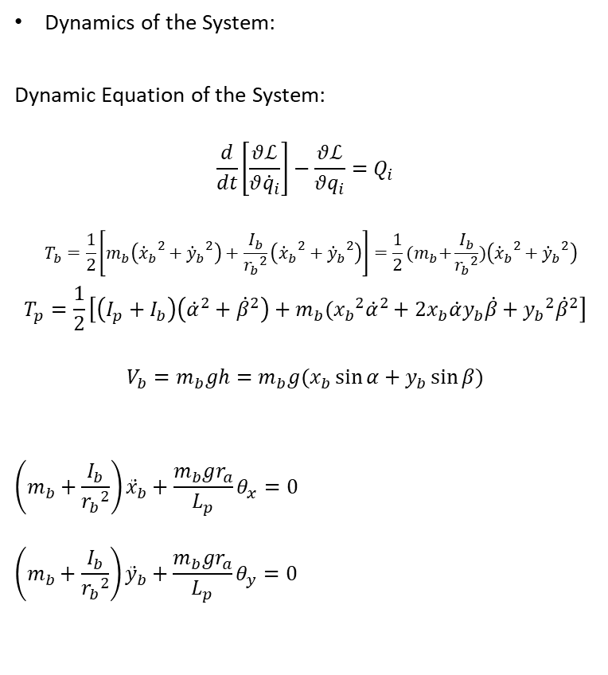
Modelling
Dynamics of the System:
Dynamic Equation of the System:
$$\frac{d}{dt}\left[\frac{θℒ}{θ{\dot{q}}_{i}}\right]−\frac{θℒ}{θq_{i}}=Q_{i}$$
$$T_{b}=\frac{1}{2}\left[m_{b}\left({{\dot{x}}_{b}}^{2}+{{\dot{y}}_{b}}^{2}\right)+\frac{I_{b}}{{r_{b}}^{2}}\left({{\dot{x}}_{b}}^{2}+{{\dot{y}}_{b}}^{2}\right)\right]=\frac{1}{2}{(m}_{b}+\frac{I_{b}}{{r_{b}}^{2}})\left({{\dot{x}}_{b}}^{2}+{{\dot{y}}_{b}}^{2}\right)$$
$$T_{p}=\frac{1}{2}\left[\left(I_{p}+I_{b}\right)\left({\dot{α}}^{2}+{\dot{β}}^{2}\right)+m_{b}({x_{b}}^{2}{\dot{α}}^{2}+2x_{b}\dot{α}y_{b}\dot{β}+{y_{b}}^{2}{\dot{β}}^{2}\right]$$
$$V_{b}=m_{b}gh=m_{b}g(x_{b}\sin{α}+y_{b}\sin{β})$$
$$\left(m_{b}+\frac{I_{b}}{{r_{b}}^{2}}\right){\ddot{x}}_{b}+\frac{m_{b}gr_{a}}{L_{p}}θ_{x}=0$$
$$\left(m_{b}+\frac{I_{b}}{{r_{b}}^{2}}\right){\ddot{y}}_{b}+\frac{m_{b}gr_{a}}{L_{p}}θ_{y}=0$$

Slide 5
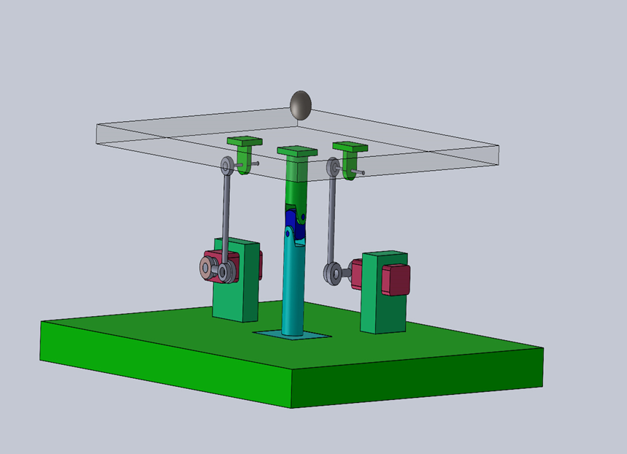
Modelling
CAD Model Properties:
2 Servo Motors for actuation.
Universal Joint for the table, 2 cylindrical joints for the arms.
Platform is from glass. Arm heads and joints are from generic alloy steel and their connecting rods are from polymer. Finally, base along with servos are mainly plastic.

Slide 6
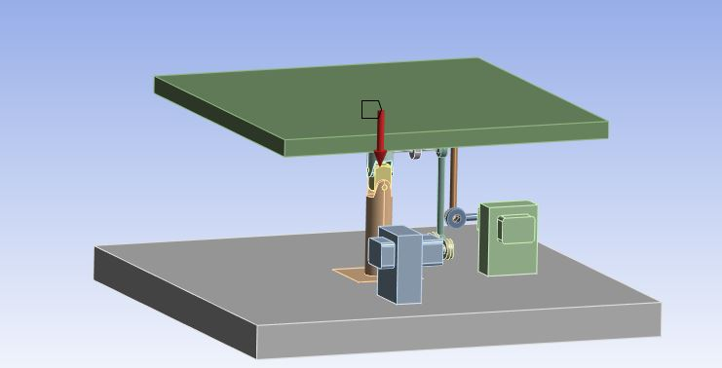
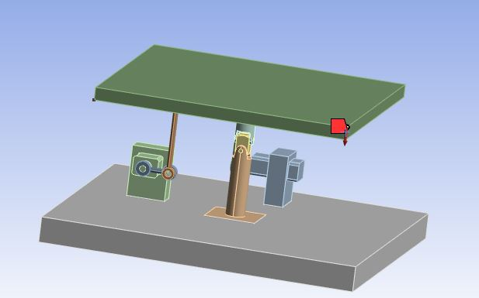
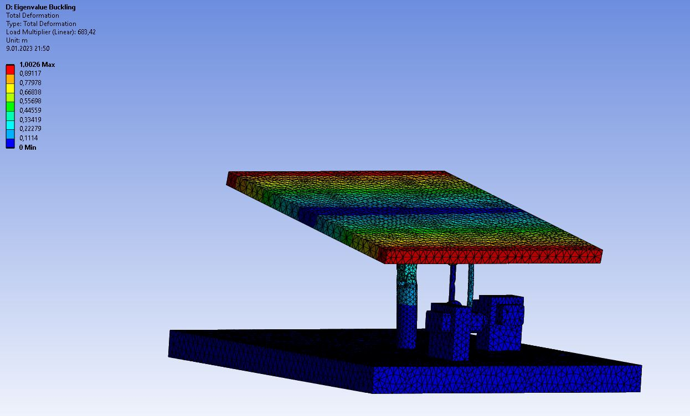
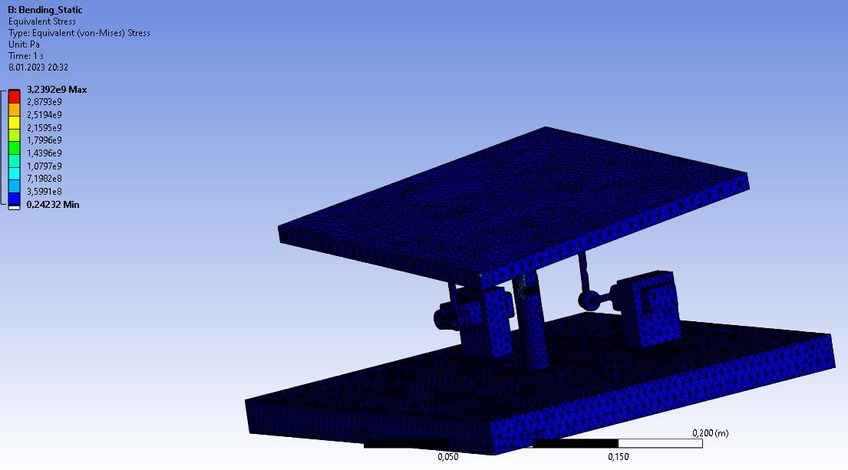
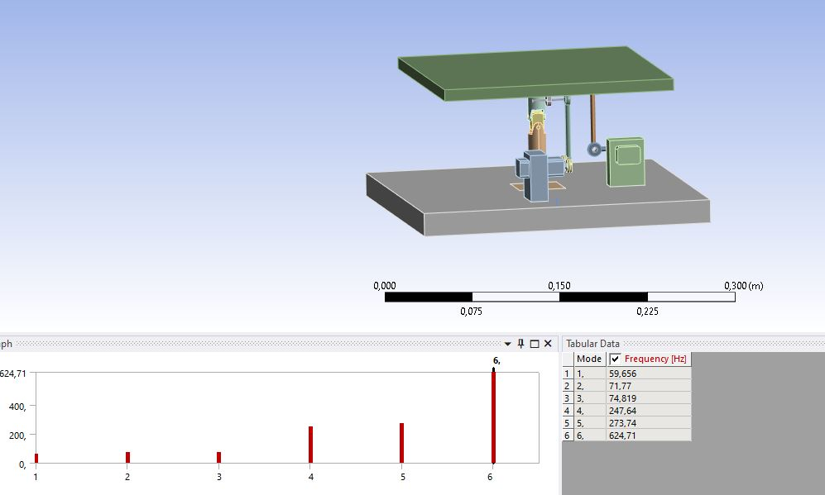
Modelling
Structural Tests for Bending, Buckling and Frequency Analysis:
 |  | Results are provided along with project files for further inspection.

Slide 7
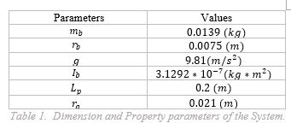

Simulation/Control
Control Theory:
$G\left(s\right)=\frac{X_{b}(s)}{θ_{x}(s)}=−\frac{m_{b}gr_{a}}{L_{p}\left(m_{b}+\frac{I_{b}}{{r_{b}}^{2}}\right)s^{2}}\frac{rad}{m}$
$G\left(s\right)=\frac{0.4216}{s^{2}} \frac{deg}{cm}$
$G_{M}\left(s\right)=\frac{θ(s)}{V_{M}(s)}=\frac{K_{M}}{t_{s}s+1}=\frac{100}{0.01s+1}$
$\frac{Output Signal}{Input Signal}=\frac{(K_{p}+K_{d}s)(G\left(s\right))(G_{M}\left(s\right))}{1+(K_{p}+K_{d}s)(G\left(s\right))(G_{M}\left(s\right))}$
$0.01s^{3}+s^{2}+40.6K_{d}s+40.6K_{p}=0$
$A=0.01, B=0.92$, $K_{p}=0.57, K_{D}=0.18$

Slide 8
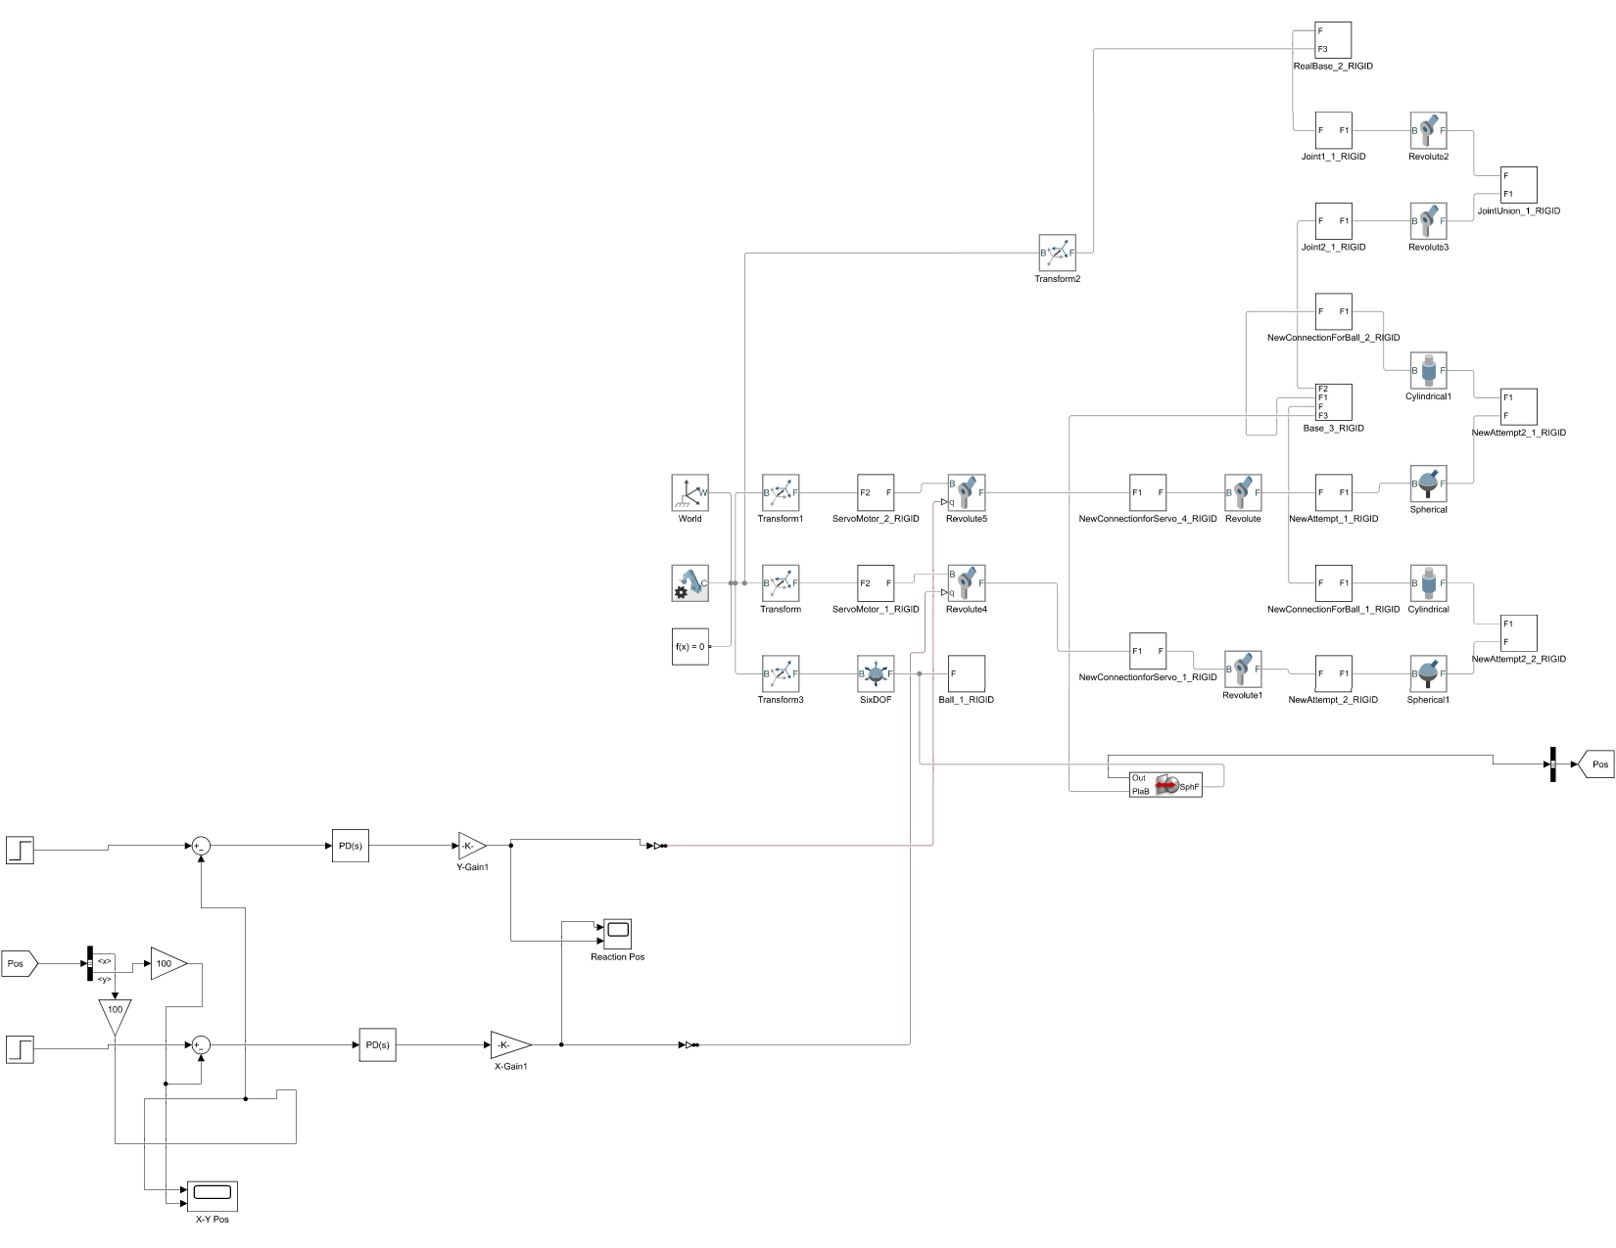
Simulation/Control
Simscape Multibody Environment

Slide 9
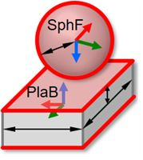
Sensing
Sphere to Plane Force Block Working Principle:

Slide 10

The End
Thank you for listening.

